Slide 1
Amphitheater School District Reopening
Special Governing Board Meeting
September 15, 2020

Slide 2
Meeting a complicated challenge
Once in a century event.
Unknowns and uncertainties abound and evolve.
Divergent, even competing opinions and data.
Recent events having impact.
Parent needs for reopening of in-person school.
Parent concerns about health and safety.
Staff desires to reopen schools for in-person learning.
Staff concerns about health and safety.
Business and community needsfor reopening.
Social-emotional impacts of closure and the pandemic generally on students, staff, and community.
Student desires to return to school, friends, activities.
Student worries about their futures and opportunities.
Digital access inequities – for students and staff.
Food insecurities for students.
Traumatic experiences for students.
District funding at risk with decreased enrollment and attendance.
Staff losses and shortage generally.

Slide 3
A Quick Review.)
March 13 (a Friday): We left for Spring Break, to return Monday, March 23.
March 15 (Sunday): Governor closes schools until March 27.
March 23-27: Educational Enrichment Efforts begin.
March 27: Legislation mandated rules and funding protections for schools
March 30: Governor extends closure for rest of SY
March 30: Online education begins.
In the ensuing weeks, fluidity of the situation grew.
May 4: Formation of a Blue Ribbon Task Force on Reopening in this school year
Week of May 18: The school year ends; School to start Aug. 6
June 29: Governor orders continuation of closure to Aug 17
July 23: Governor directs that districts consider guidance from state and local health departments to determine how and when to reopen schools.

Slide 4
Amphitheater’s Approach
The District weighed all of the factors—COVID numbers, health issues, wellbeing of children and adults, health needs, learning needs—and formulated what we believed to be the best plan for our community.
1
Opened school Aug. 10 in the “Remote by Necessity” model for all students who want to attend in-person school eventually.
2
Offered an “Online by Request” model for families who wish to remain in online school even after in-person school their children attend school in-person even when it does become available (approx. 800 students)
3
Stand ready for “In-Person Learning” when our public health officials advise it is safe to do so.

Slide 5
Choices for Families
Amphitheater Public Schools have given families choice to have their children attend school in person (when possible) or entirely online through the District.
1
2
In-person learning with health and safety measures in place
Online learning by request
1A: When school buildings are closed, this shifts to the “Remote Learning by Necessity” model.

Slide 6
Key Points to Remember
1
We must be flexible. We are prepared to make changes to this plan as necessary depending on the situation in our community, state, and nation.
2
Amphitheater will follow applicable orders or guidance issued by national, state and local leaders as they apply to the District and the reopening of schools.
3
Amphitheater’s reopening plan is guided by the Arizona Department of Education’s Roadmap for Reopening and CDC/AZDHS/PCHD public health guidelines for reopening.
4
Pima County has ordered everyone over 5 years old to wear a mask except when they cannot keep 6 feet of physical distancing (with some exceptions). District policy now echoes this.

Slide 7
Surveys: Main Takeaways
1
4
Health and safety are main concerns for families and staff.
Some families are in situations where they must have a remote schooling option.
2
5
Students need the consistency and support provided by in-person education.
Class sizes and the ability to provide social-distancing are common concerns for families and employees.
3
6
Most people are willing to wear masks and socially distance when possible if that means students can attend school in-person.
Finding solutions that work for everyone is impossible, no matter how hard we try.

Slide 8
Where do things stand now?
We have been watching state and local (most relevant) data for indicators allowing us to resume in-person learning.
After a period of indicators climbing in wrong direction, more recent weeks have shown declines (the right direction).
State’s reopening benchmarks: 3 of 3 met.
County’s reopening benchmarks – all yellow and green are required for partial (hybrid) opening; all green required for full in-person opening

Slide 9
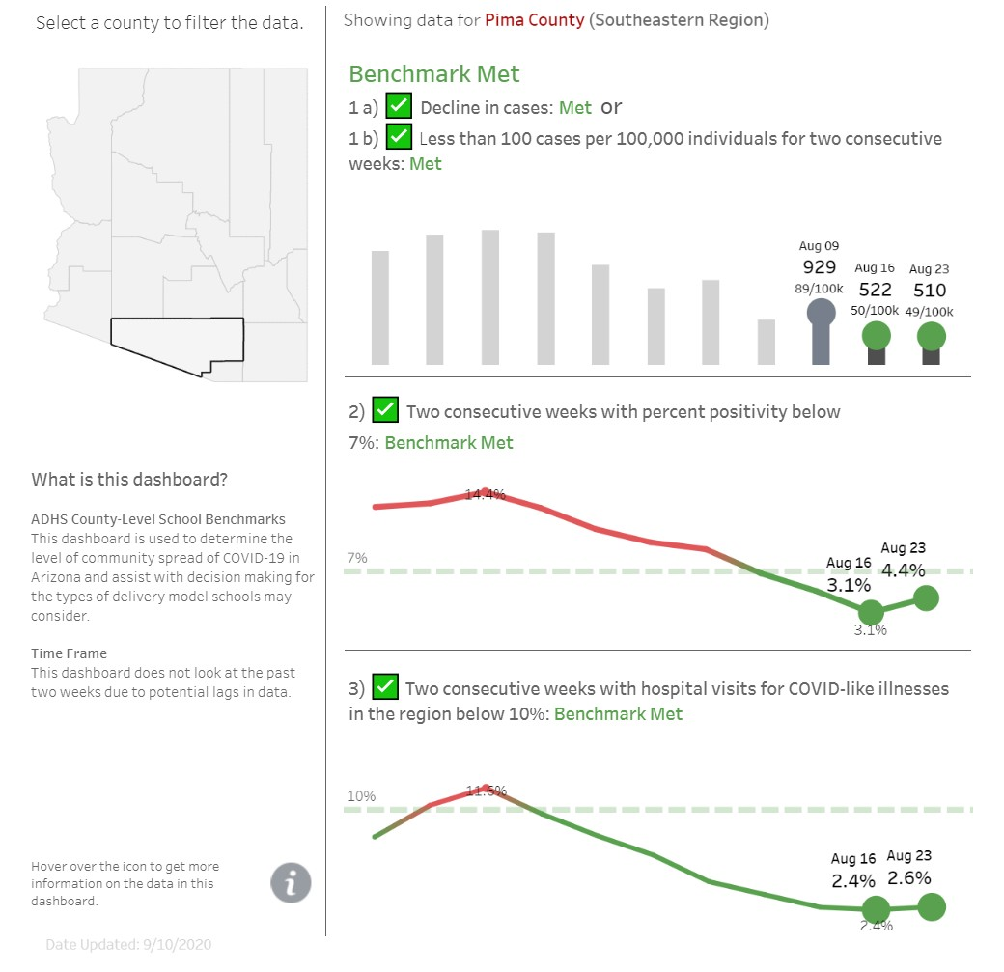
ADHS Data for Pima
9/14/2020
7
https://www.azdhs.gov/preparedness/epide miology-disease-control/infectious-disease- epidemiology/index.php#novel-coronavirus- schools

Slide 10
PCHD Recommended Return to School Criteria
9/14/2020
8
1. Disease Criteria
2. Healthcare Capacity Criteria
3. Public Health Capacity Criteria
A Healthy Pima County. Every one. Everywhere. Every day.

Slide 11
Where do things stand now?
PCHD Indicators Summary
1
7
1
Current metrics guide against reopening in any form presently. Metrics are expected to improve, however, and support potential hybrid openings very soon.
When all indicators are green: full reopening is possible.

Slide 12
Full Reopening
This agenda item originally proposed a full reopening after Amphi Fall Break (Oct. 12) based upon a trajectory of improving metrics.
Recent local pandemic events have called the trajectory into question.
PCHD advised yesterday that all metrics “going green” within the next few weeks will not happen; indeed, it appears that conditions will only support hybrid instruction for the entirety of October.
Full in-person reopening on October 12 is not advised.
Parent and Staff surveys conducted to assess interests and potential participation demonstrated that most intend to attend reopened schools as soon as possible.

Slide 13
Recent Survey of Families and Staff
To seek feedback on mitigation efforts and plan components
Cleaning and Sanitation
PPE/Health and Safety
Contact Limitations
Communication
Transportation
Food and Nutrition
Individualized feedback on learning model(s) choices in event of full reopening for in-person learning on October 12

Slide 14
Family and Staff Surveys
Michelle Valenzuela
Director of Communications

Slide 15
Re-Opening Schools Surveys
We sent three surveys last week. Two were parent surveys—one for elementary school parents and one for middle and high school parents. The questions were the same, except for having content specific to school level. On the secondary survey, we added a question about extracurricular activities.
1,780
Elementary Family Survey
2,483
Secondary Family Survey
1,198
Employee Survey

Slide 16
About the surveys
Each survey contained information about mitigation measures the District plans to implement in several categories. The survey then asked participants to respond to a prompt. Example:
Please review the Cleaning and Sanitation measures that will be in place for reopening in-person learning and then respond to the prompt below.
All desks and chairs will be cleaned after every class. Students may assist with the cleaning of their own desks. Teachers may spray, and students may wipe desks.
Hand sanitizer and/or soap and water will be available in every classroom.
Alcohol wipes will be available to sanitize computer keyboards and other devices.
Rooms will be ventilated to the extent possible.
Libraries and maker spaces will require hand-washing/sanitizing before entering.
Libraries will set aside returned items for the time period recommended by the CDC before handling.
A COVID-19 Response Team has been formed that can respond to a suspected case of COVID-19 to provide deep sanitizing of necessary areas.
Additional custodial staffing and grounds-keeping duties for added cleaning of facilities and playground equipment (touchpoints).
Prompt: I am satisfied with the Cleaning and Sanitizing measures described.

Slide 17
About the surveys
At the end of each survey, we asked a question about plans for the future. We asked parents about what type of learning model they expected to choose for their children, and we asked employees about their plans for their work.
It’s important to note that these surveys were not anonymous and that the answers were non-binding for families and employees.

Slide 18
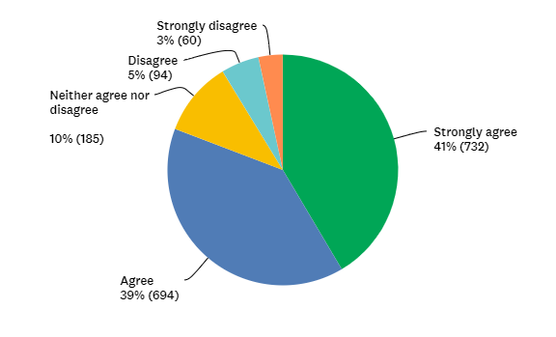
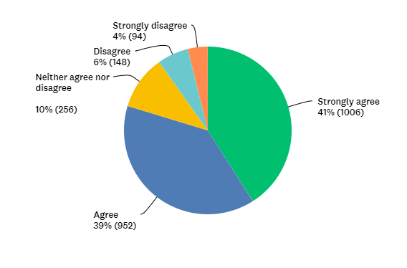
Cleaning and Sanitizing
Elementary Families
Secondary Families

Slide 19
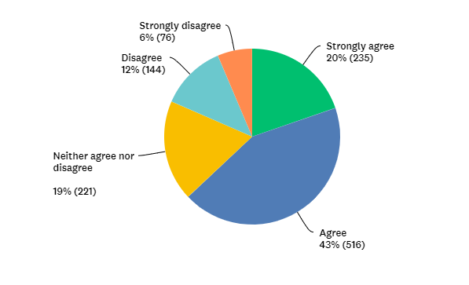
Cleaning and Sanitizing
Employees

Slide 20
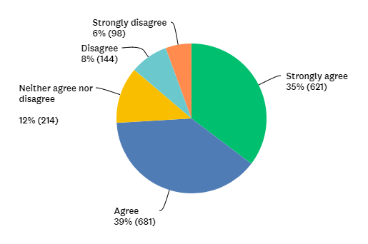
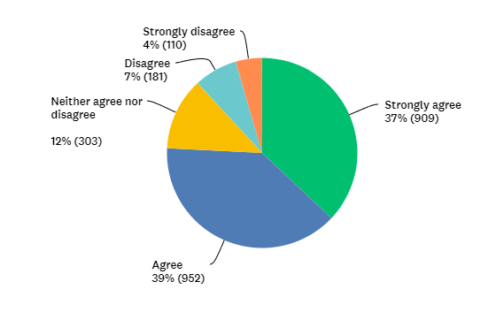
PPE/Health and Safety
Elementary Families
Secondary Families

Slide 21
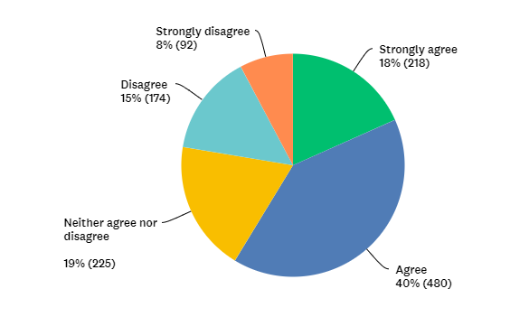
PPE/Health and Safety
Employees

Slide 22
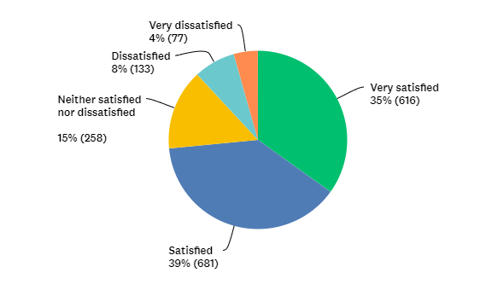
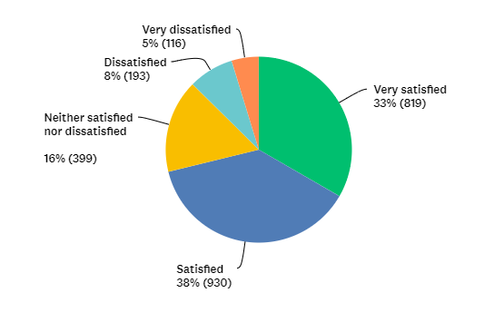
Contact Limiting
Elementary Families
Secondary Families

Slide 23
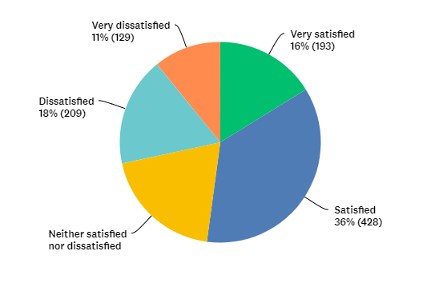
Contact Limiting
Employees

Slide 24
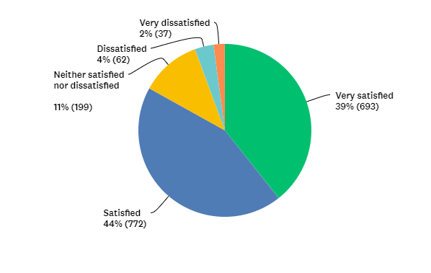
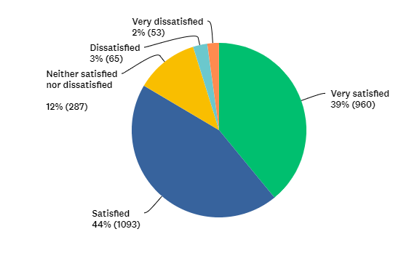
Communication
Elementary Families
Secondary Families

Slide 25
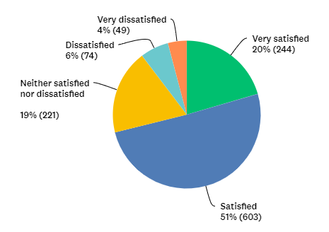
Communication
Employees

Slide 26
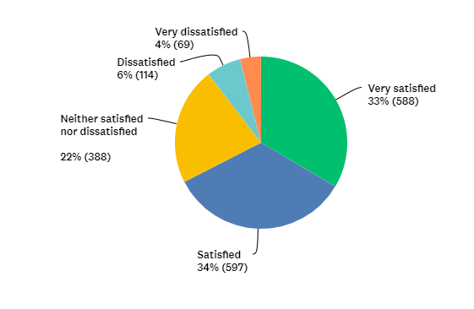
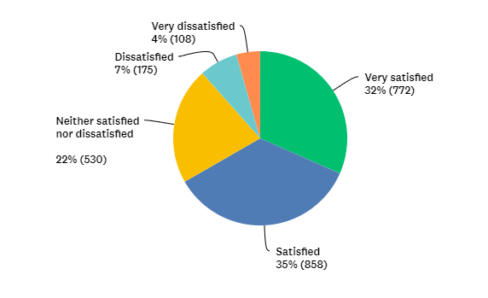
Transportation
Elementary Families
Secondary Families

Slide 27
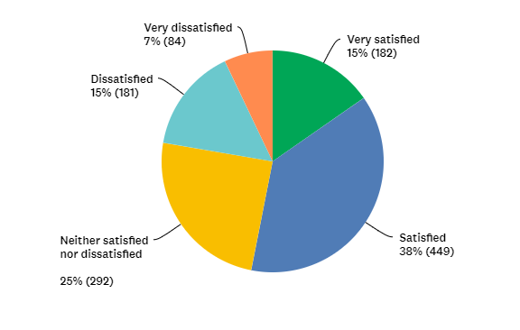
Transportation
Employees

Slide 28
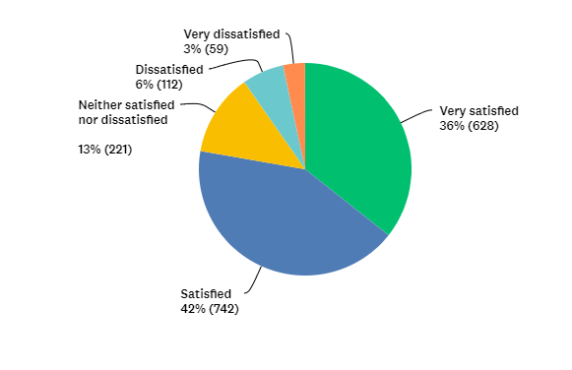
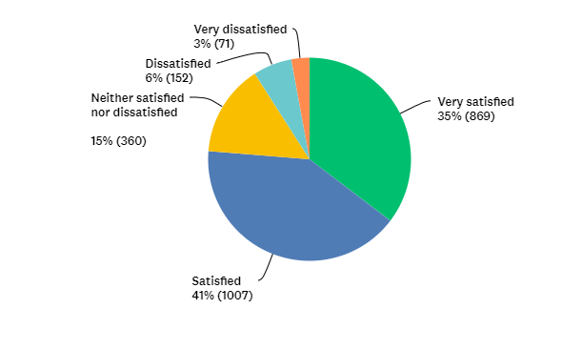
Food and Nutrition
Elementary Families
Secondary Families

Slide 29
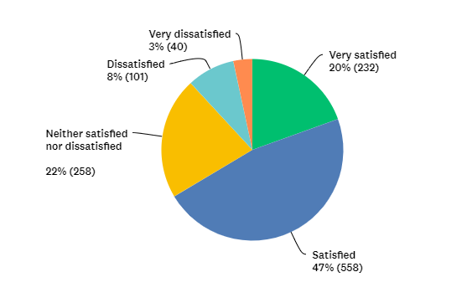
Food and Nutrition
Employees

Slide 30
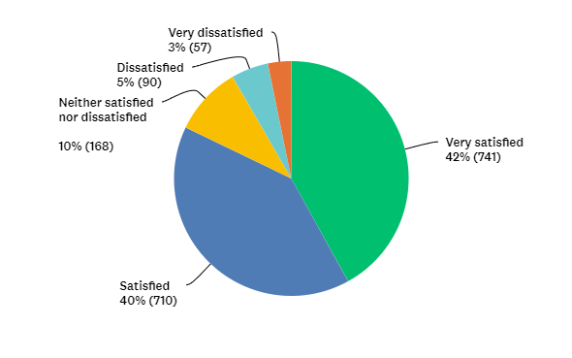
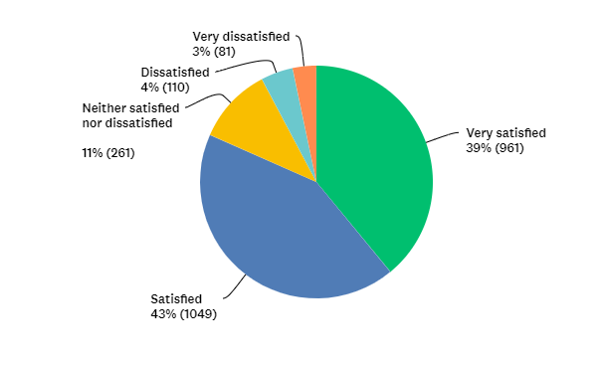
Education Services
Elementary Families
Secondary Families

Slide 31
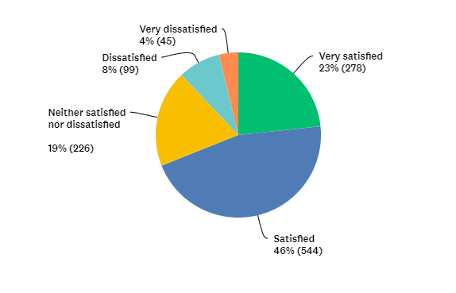
Education Services
Employees

Slide 32
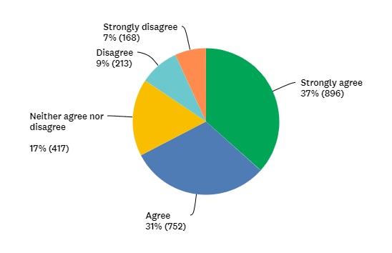
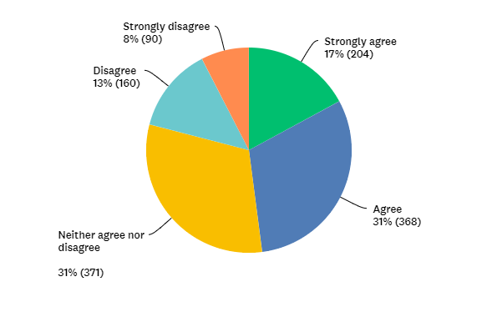
Extracurricular Activities
Secondary Families
Employees

Slide 33
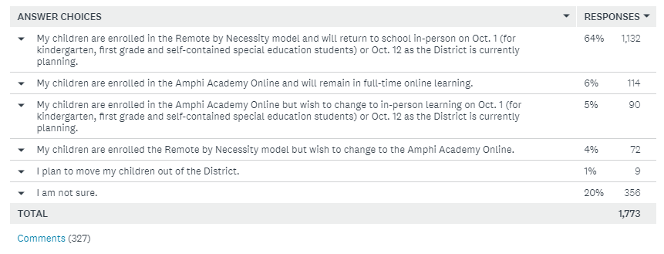
Elementary Family Survey
Q: Please choose the option that best describes your plans for your children. This is for our information as we plan. Your answer will not impact your student's current learning option.

Slide 34
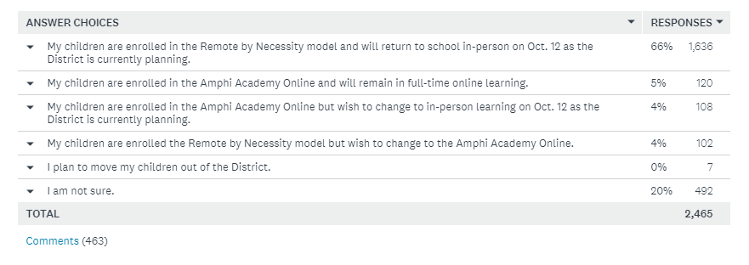
Secondary Family Survey
Q: Please choose the option that best describes your plans for your children. This is for our information as we plan. Your answer will not impact your student's current learning option.

Slide 35
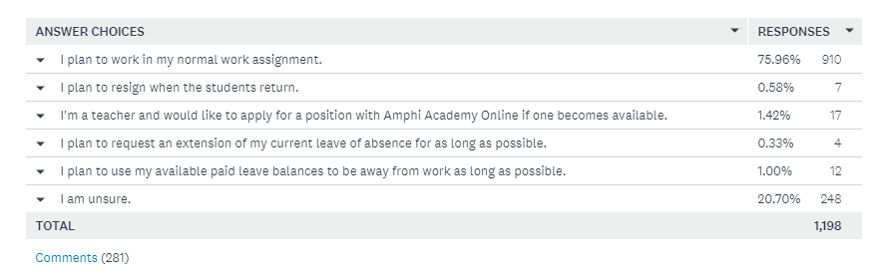
Employee Survey
Q: Please choose the option that best describes your plans for your children. This is for our information as we plan. Your answer will not impact your student's current learning option.

Slide 36
How do we reopen?
Reopening is an absolute priority, but it must be done safely and in accordance with guidance from our public health systems.
A quarter of the school year has been conducted online, and a majority of our students and parents want to return to school as soon as possible.
We now know that full in-person reopening after Amphi Fall Break (Oct. 12) will not be possible.
Hybrid Model: previously considered for the start of school but discounted at the time, because of health conditions which did not support its implementation and other factors.
The learning needs of our children must be the primary consideration so long as the safety of all can be assured.
A hybrid model, while not perfect, can strike the balance.

Slide 37
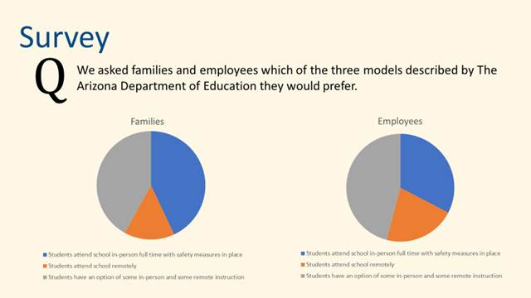
In a survey conducted in July, 43.38% of families wanted full-time in-person instruction when school resumed with safety measures in place; 41.89% wanted hybrid instruction (some remote and some in-person). Only 14.73% desired remote instruction exclusively.

Slide 38
What are other Districts doing?
Status of Public School District Instructional Activity
School District | Instructional | Target Date
Ajo Unified | Hybrid | 10/7/2020
Altar Valley Elementary | Hybrid | 10/19/2020
Baboquivari Unified | Board will decide on remote, hybrid, or in- person | 10/7/2020
Catalina Foothills Unified | Remote | Pending
Continental Elementary | Hybrid | 9/10/2020
Flowing Wells | Hybrid | 10/5/2020
Marana Unified | Hybrid | 10/19/2020
Pima Accomodation District | Hybrid | 8/31/2020
Sahuarita Unified | Hybrid | 9/17/2020
San Fernando Elementary | in-Person | 10/12/2020
Sunnyside Unified | Hybrid | 10/15/2020
Tanque Verde Unified | Hybrid | 10/19/2020
Tucson Unified | Hybrid | 10/19/2020
Vail Unified | Hybrid | 9/21/2020
Data reported by PCHD as of 9-14-20

Slide 39
School Hybrid Reopening Plans
Dr. Roseanne Lopez, Associate Superintendent for Elementary Education
Michael Bejarano, Associate Superintendent for Secondary Education

Slide 40
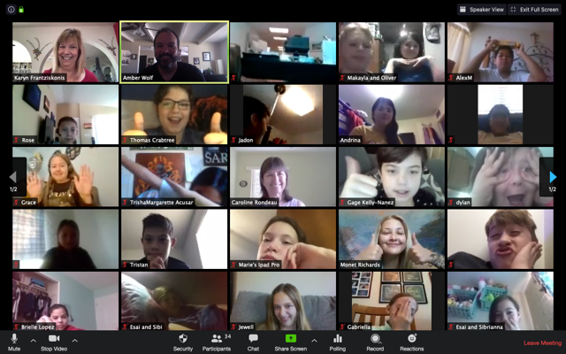
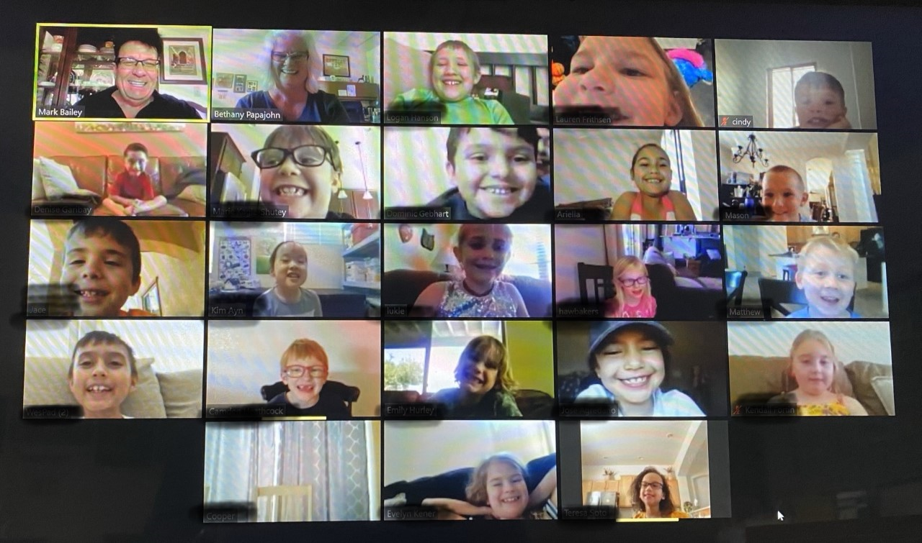

Slide 41
Possible Elementary Hybrid Model
All students are assigned to Cohort #1 or Cohort #2.
Monday and Thursday (Cohort #1 for each grade level and classroom attends school all day; assignments issued for the next day for remote learning)
Tuesday and Friday (Cohort #2 for each grade level and classroom attends school all day; assignments issued for the next day for remote learning)
Wednesday all students are home for online learning. Teachers schedule small group instruction as needed for acceleration, intervention, etc.

Slide 42
What would elementary school like?
Classes will be half their current size
Students will be seated as far apart as possible
Students will wear masks
Lunch tables and seating will be at least six feet apart, students will eat with their grade level cohort
Students will have their own supplies
Students will wash or sanitize their hands regularly during the day, especially when transitioning to a different location as a cohort
Students will go to recess
Students will go straight to class in the morning in order to stay with their grade level cohort
Classes will be led to bus lines and the lunch room in lines, six feet apart
Parents and non-program volunteers will not be allowed on campus

Slide 43
Cohorts: How they help contain the spread….
Elementary students will be contained in their grade level cohort throughout the school day.
Students will eat lunch with their grade level peers, have recess with grade level peers, and will not interact with children in other grade levels to the extent possible.
WHY?: Containment of potential outbreaks of COVID-19.
Notes:
of two or more people, and it is deemed to be school related, there is a possibility that one grade level of the school could be sent home to quarantine rather than a whole school. This plan may or may not work depending upon whether it was a staff member or whether a positive student had siblings at the same school in other grade levels.

Slide 44
Mondays | A – L (In Person) Cohort #1
 | M – Z (Remote Learning Assignments on software, projects, reading, math practice) Cohort #2
Tuesdays | A – L (Remote learning assignments on software, projects, reading, math practice) Cohort #1
 | M – Z (In Person) Cohort #2
Wednesdays | Zoom Live / Remote Learning Assignments on software/other
Thursdays | A – L (In Person) Cohort #1
 | M – Z (Remote learning assignments on software, projects, reading, math practice) Cohort #2
Fridays | A – L (Remote learning assignments on software, projects, reading, math practice) Cohort #1
 | M – Z (In Person) Cohort #2
Elementary Hybrid Schedule
*Specialists schedules will be modified/rotated

Slide 45
Elementary Hybrid Models: Pros
Reduces class size by half
Increases the ability to social distance
Reduces number of students in hallways, cafeterias and buses
Students are in school in person for part of the week
Students get to see some of their friends, their teacher, and other staff members in person
Students receive more direct instruction from their teacher than under the current model
Helps students with issues related to isolation
Students who need in person assistance can get the assistance

Slide 46
Elementary Hybrid Models: Cons
Teachers must teach in person and online in some form throughout the week resulting in a heavier workload (e.g., lesson planning for remote learning and lesson/activity planning for in-person learning)
Young children would work 2-3 days per week on online software and packet work without teacher “ZOOM” lessons
Maintaining continuity of instruction will be challenging
Reduction in content taught
Working parents may find it difficult to find childcare with a hybrid schedule
If in childcare on off days, could bring the virus to school from the daycare
Logistical challenges for families with students spread across multiple grade levels and schools
May require more teaching staff
Requires parent or caregiver involvement
Specialists and extracurricular activities will need to alter schedules

Slide 47
What would Secondary School look like?
Mondays | A – L (In Person)
 | M – Z (Google Classroom)
Tuesdays | A – L (Google Classroom)
 | M – Z (In Person)
Wednesdays | Zoom Live / Google Classroom
Thursdays | A – L (In Person)
 | M – Z (Google Classroom)
Fridays | A – L (Google Classroom)
 | M – Z (In Person)
Siblings with different last names could attend school, in-person, based on the older sibling’s last name

Slide 48
Secondary Hybrid Models: Pros
Time for smaller groups of students to acclimate to new procedures
Reduce the number of physical interactions by limiting the number of students on campus and on buses
Increase the opportunity to provide proper social distancing
Reduce overcrowded classrooms, hallways, cafeteria/MPR and common areas. Management of students in these shared spaces will be more effective Increase opportunities for teachers to provide 1:1 support to students as they transition back to campus
Continued to use of Zoom and Google Classroom allows for smoother transition back to Remote Learning by Necessity if needed
Attendance can be taken using same practices currently used in Remote Learning by Necessity Allows for flexibility
Transition is easier for students as they are currently utilizing synchronous and asynchronous learning
Allows teachers to provide consistent Tier I and Tier II interventions
Students can benefit from technology on campus
Another option for parents as online learning has proven to be difficult

Slide 49
Secondary Hybrid Models: Cons
Additional commitment by staff to prepare lessons and provide meaningful instruction to two groups of students on a daily basis
Possible loss of instructional minutes and ADM
Providing support and instruction for students without technology
Requires teachers to take attendance for online and in-person students
Families with multiple age children who rely on older children to care for younger siblings will have a difficulty time if schedules are different
Students who have trouble with time management may struggle with keeping track of synchronous and asynchronous learning
Chromebooks that are assigned to students away form campus are not available to students on campus
Transportation for students participating in extra-curricular activities

Slide 50
Concluding Remarks
Notes:
Welcome back.
I’m sorry we cannot be together as we normally are. After not seeing you all for months, I was really looking forward just to seeing your faces in person, as I’m sure many of you were looking forward to seeing one another – your peers, your colleagues, your friends, your Amphi Family.
We’re gonna get there . We’re gonna get back to normal. But Just not as soon as we had hoped.
Everything is starting off different this year, including this traditional kick-off of ours. We’re going to keep it simple and relatively short.
And as we begin this morning, not only want to welcome most of you “back”, but also welcome our newest leaders. We’ll all get to introduce ourselves to them I hope very soon, but right now, I’d just like to give them a few minutes to introduce themselves.
STOP Sharing and call on them one by one – Please just tell us your name and a little bit about yourselves when I call on you .

Slide 51
Questions?
Notes:
Welcome back.
I’m sorry we cannot be together as we normally are. After not seeing you all for months, I was really looking forward just to seeing your faces in person, as I’m sure many of you were looking forward to seeing one another – your peers, your colleagues, your friends, your Amphi Family.
We’re gonna get there . We’re gonna get back to normal. But Just not as soon as we had hoped.
Everything is starting off different this year, including this traditional kick-off of ours. We’re going to keep it simple and relatively short.
And as we begin this morning, not only want to welcome most of you “back”, but also welcome our newest leaders. We’ll all get to introduce ourselves to them I hope very soon, but right now, I’d just like to give them a few minutes to introduce themselves.
STOP Sharing and call on them one by one – Please just tell us your name and a little bit about yourselves when I call on you .

